Slide 1
Basic Testing Concepts

Slide 2
What is Testing?
Software testing is a process of analyzing a software to detect the differences between existing and required conditions (i.e. defects/errors/bugs) and to evaluate the features of the software.
Testing is the process of checking a system and/or its components against specification to determine whether the system meets those requirements.
Software testing can be done either manually (by a human using the system) or it can be automated by writing tests with code.
Usually when we discuss software testing, we are referring to the latter (automation).
There are many existing software libraries and frameworks in many languages that can assist with testing.
Writing tests is a crucial way to ensure the quality and effectiveness of a piece of software.

Slide 3
What is Testing?
Testing should not be...
Optional
An afterthought
A chore
Time-consuming
Strictly about code coverage

Slide 4
What is Testing?
When creating and executing tests, you want to make sure that you:
Clarify and unambiguously state the requirements of the system
Ensure software meets the stakeholders' expectations, and helps achieve business objectives
Can easily identify areas that do not meet requirements
Quickly and easily make changes to your application and tests if needed
Assure product quality

Slide 5
Testing Principles
Exhaustive testing is not possible
Exhaustive testing means testing every possible input to a system. This is impossible outside of trivial applications
Instead of testing every single aspect and scenario imaginable, it is better to determine the optimal amount of testing based on cost vs benefit and risk management
Defect Clustering
Defect clustering is based on an application of the Pareto principle which states that a small number of modules contain most of the defects detected (approximately 80% of the problems are found in 20% of the modules).
Also, this implies that once a defect is found, the surrounding code should be well tested because more defects are likely to be found around it

Slide 6
Testing Principles
"Pesticide Paradox“
When the same pesticide mix is used to eradicate insects during farming, over time the insects will develop resistances to the pesticide, thereby making it ineffective on insects. The same principle can be applied to software bugs!
Test cases should be regularly reviewed and revised, adding new and different test cases to help find more defects.
Testing shows a presence of defects
Testing shows the presence of defects, not the lack of them. This means that, even if you do not find a problem, does not mean it does not exist. Enough test cases should be developed to robustly check a system's requirements.

Slide 7
Testing Principles
Absence of Error Fallacy
Even if software is 99% bug-free it can still be unusable. This can be the case if the system is tested thoroughly with the wrong requirement. Software testing is not just about finding problems, but also checking that software meets the required needs of the business.
Early Testing
Defects identified later in the software development lifecycle are more expensive to fix (bugs found in production or more costly than bugs found before deployment)
Testing should start as early as possible in a software's development as early testing can prevent costly problems which may arise later during a product's development

Slide 8
Testing Principles
Testing is context dependent
The way tests are performed depends on the end-product and requirements for the product. For example, an e-commerce site is difference from an off-the-shelf application, and as such the tests should reflect these differences

Slide 9
Software Testing Life Cycle

Slide 10
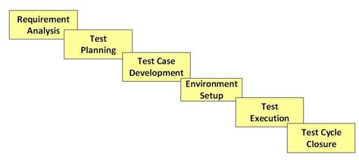
Software Testing Life Cycle
The Software Testing Life Cycle (STLC) is a sequence of specific phases and activities which are conducted during the testing process to ensure software quality goals are met.
The STLC is not a singular activity but rather a series of steps taken to help certify software quality.
Each phase includes an "Entry" and "Exit" criteria which determine certain items which must be completed before a phase can begin or be concluded, respectively, many of these include certain testing documents.
This software testing lifecycle is applied differently in different development contexts.
In a waterfall environment, the testing lifecycle may start after project development finishes.
In an Agile environment, software testing is conducted alongside application development and continually evolves

Slide 11
Requirement Analysis
At the start of the Software Testing Lifecycle is the Requirement Analysis Phase, in which the test team studies the software requirements to identify what systems must be tested and potentially discuss requirements with stakeholders to understand all details.
Requirements may be function or non-functional.
Entry Requirements
Requirements Document Available (functional and non-functional)
Acceptance Criteria Defined
Application Architecture documentation available
Determine types of tests to be performed
Specify testing priorities and focus Identify test environment details
Produce the Requirement Traceability Matrix (RTM)
Exit Requirements
RTM has been approved

Slide 12
Test Planning
During the Test Planning Phase a QA manager or senior member will determine and draft the test plan strategy as well as the level of effort and cost estimates for the project. During this phase the resources, test environment, test limitations and schedules are also determined.
Entry Requirements
RTM Available
Requirements Document Available
Test tools are selected
Test efforts are estimated
Roles and Responsibilities are determined
Senior QA member will determine cost estimates
Test plan document is created
Exit Requirements
Test Plan Document Approved
Effort Estimation Document Approved

Slide 13
Test Case Development
The Test Case Development Phase sees the creation of test cases, test scripts and any required test data using the established test plan. These components are then reviewed and refactored as needed based to meet the requirements of the product. This phase can be done in parallel with the Test Environment Setup.
Entry Requirements
Requirements, RTM and Test Plan Documents Available
Test cases are developed
Test data is created
Exit Requirements
Test cases planned and initial scripts created
Test Data has been created

Slide 14
Test Environment Setup
During the Test Environment Setup, software and hardware conditions, which replicate the conditions of the work product, are created and tested. This phase can be done in parallel with the Test Case Development Phase.
Entry Requirements
System Design and Architecture Documents available
Environment set-up plan established
Software/Hardware conditions which match the final product environment are prepared
Smoke tests can be performed at this step on the build
Exit Requirements
Environment ready with test data established
Smoke Test Results show no problems with environment

Slide 15
Test Execution
Developed Test cases are carried out by the testers during the Test Execution Phase. This process consists of test script execution, script maintenance, reporting bugs, retesting, and generating reports.
Entry Requirements
RTM and Planned test cases are available
Test environment is ready
Tests are executed per the test plan
Defects are mapped to the RTM
Defects are tracked if found
Exit Requirements
All planned tests are executed
Found defects are logged and tracked to their closure

Slide 16
Test Cycle Closure
The final phase, Test Cycle Closure, marks the completion of test execution and involves several activities, including a meeting to discuss and analyze the reports and other artifacts and identify successful strategies and takeaway lessons from the test cycle.
Entry Requirements
All testing has concluded
Test results are available
Defect logs are available
Testing team meets to evaluate cycle completion based on time, code coverage, cost, software, business objectives and quality
Metrics are recorded based on finding
Test closure reports are generated
Exit Requirements
Closure of Testing is signed off by client

Slide 17
Waterfall Testing
Waterfall testing is based on the waterfall model, which divides the project into sequential phases, such as requirements, design, development, testing, and deployment.
Each phase must be completed and approved before moving to the next one, and changes are difficult to implement once the project is underway.
Waterfall testing is usually done at the end of the development phase, after the software is fully coded and integrated.
The testing team follows a predefined test plan and uses formal methods to document and report the defects.

Slide 18
V Model Testing
V Model is a highly disciplined SDLC model which has a testing phase parallel to each development phase.
The V model is an extension of the waterfall model wherein software development and testing is executed in a sequential way.
It is known as the Validation or Verification Model.

Slide 19
Agile Testing
Agile testing is based on the agile methodology, which emphasizes collaboration, feedback, and adaptation throughout the project.
The project is divided into short iterations, called sprints, where the team delivers working software that meets the customer's needs and expectations.
Agile testing is done continuously, from the beginning of the project until the end, and involves the whole team, not just the testers.
The testing team follows an adaptive test plan and uses informal methods to communicate and resolve the defects.

Slide 20
Differences between agile and waterfall testing
One of the main differences between agile and waterfall testing is the timing and frequency of testing.
In waterfall testing, testing is done once, at the end of the development phase, and it may take a long time to complete.
In agile testing, testing is done throughout the project, in every sprint, and it is done in parallel with development.
This means that agile testing can detect and fix defects earlier, reduce rework, and deliver faster feedback.

Slide 21
Differences between agile and waterfall testing
Another difference is the scope and flexibility of testing.
In waterfall testing, testing is based on a fixed scope and requirements that are defined upfront and rarely change.
In agile testing, testing is based on a dynamic scope and requirements that are constantly evolving and prioritized by the customer.
This means that waterfall testing can ensure compliance and completeness of the software, but it may not meet the changing needs and preferences of the customer.
Agile testing can respond to changes and deliver value to the customer, but it may not cover all the possible scenarios and risks of the software.

Slide 22
Defect Life Cycle

Slide 23
Problems During Development
Error
Errors are issues in the code which prevent compilation or running of the actual code.
Some errors can be found prior to any formal testing phases.
Bug
Bugs are faults found which impact the performance or functionality of a system or application.
Bugs are generally found during unit tests
Failure
Issues which are found by the end user, after product completion.

Slide 24
Problems During Development
Defect
Defects are any systems which deviate from the expect result of an application or software's specification.
Often, bugs and defects are used interchangeably, however, a bug and defect are not synonymous.
A bug indicates that there is some sort of performance issue, or useability issue which prevents the software from correctly running, i.e. a functional error.
A defect does not necessarily mean there is a bug in the code, but that the output from some input deviates from what is expected.
Notes:
For example:
A banking system allows you to create a savings and/or checking account which can be accessed using your email.
When a user creates a new account for the platform and enters their email address, they are given the error "invald email address" when it is entered correctly. This is a bug since it impacts the performance of the actual system.
When a user creates a new account for the platform, and they select "Checking" account. Both a checking and savings account are made simultaneously. This is a defect since it deviates from the established requirements.

Slide 25
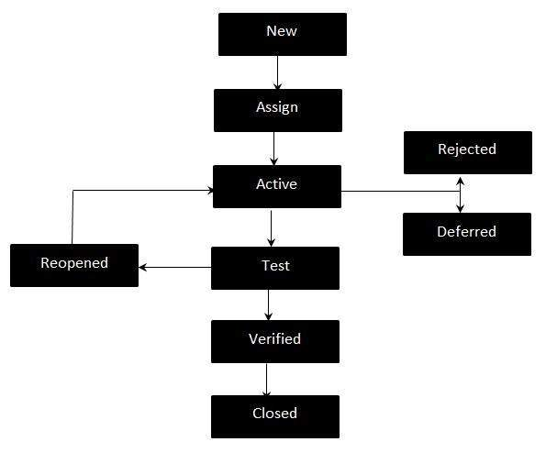
Defect Life Cycle
When issues are found during testing Defects enter what is known as the Defect Life Cycle.
These are a series of steps taken to identify, report and resolve these defects.

Slide 26
Defect Life Cycle
New
A potential defect is identified by a tester
Assign
The Defect is assigned to a development team member
Active
Defects which are being addressed by the development team
Here the developer determines if the defect is an issue, or intended or if there is insufficient resources to resolve the issue.
If the developer determines the defect cannot be resolved it will either be rejected or deferred.
If the defect can be resolved, code should be refactored and submitted to fix the issue

Slide 27
Defect Life Cycle
Reject
The defect is rejected by a developer for one of three reasons
It is a duplicate defect submitted
In this case, the defect can be closed
The defect cannot be reproduced with the given report
The defect is determined to be intentional
Defer
If the defect cannot be addressed during this cycle, the developer can defer it to a future cycle.

Slide 28
Defect Life Cycle
Test
After a developer submits a fix for a defect, the code should be tested using the same criteria which produced the defect once more (re-testing)
If the test fails again, the defect should be reopened and moved back to an active status.
If the defect is fixed, it should be moved to verification
Verify
The defect is determined to be resolved by a submitted fix
Close
The final step of the life cycle in which the defect is closed. Note, this step varies slightly from verification, in that certain defects, such as duplicate submissions, are not verified before being closed.

Slide 29
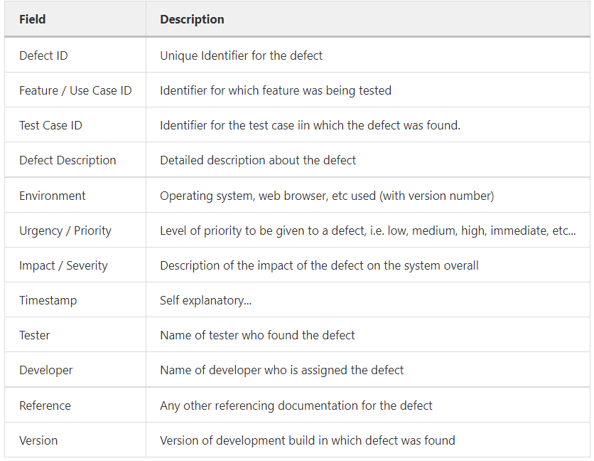
Defect Reporting

